Slide 1
D’Code 2016
DHS ICC

Slide 2
Introduction
⇒ Computing is any calculation done by a computer or any machines, that simplify work for humans.

Slide 3



Introduction
⇒ Python
→ Easy to learn, but powerful
→ Intuitive syntax
→ Used in large companies, such as Google and YouTube
Notes:
https://www.quora.com/Which-Internet-companies-use-Python
Google uses Python as a supplemental language
YouTube uses Python primarily for development

Slide 4
Content
Variables
Data Types
Getting Input
Operators
If/Else/And/Or
Loops
Lists
Functions

Slide 5
Variables
⇒ used to store values which include numbers and strings
⇒ variable names should NOT:
→ start with numbers
→ have space in between (instead, use _ )
→ use system reserves E.g. print, input, etc.

Slide 6
Assigning Variables
num = 13
variable name assignment operator value

Slide 7
Data Types
⇒ str(): string
⇒ int(): integer
⇒ float(): numbers with fractional parts/decimals
⇒ bool(): boolean (True/False)
Notes:
You should exemplify:
42 is an int
42.0 is a float

Slide 8
Printing output
⇒ print()
computer will print contents within bracket
data types include strings, integers, floats, booleans
E.g. print("I", "love", "computing")
>>> I love computing
print("I" + "love" + "computing")
>>> Ilovecomputing

Slide 9
Activity
Try to create variables, for your name, age etc and assign the relevant data to them
Then, print the variables out.

Slide 10
Getting input
⇒ using input
name = input("Enter name here:")
⇒ prompts user to enter input
Enter name here:
⇒ also assigns input to variable (i.e. name)

Slide 11
Activity
Ask the user for their job and income, then print out a response to confirm the data obtained.

Slide 12
Comparatives
= | assigning value to variable
== | checks for equality
!= | not equal
< | less than
<= | less than or equal to
> | more than
>= | more than or equal to

Slide 13
Mathematical Operations
+ | Add
- | Subtract
* | Multiply
** | Exponent
/ | Divide
// | Quotient
% | Remainder
NOTE: Python will follow BODMAS rule

Slide 14
If/else
⇒ if condition stated is fulfilled,
action will be executed.
if <condition1>:
<action1>
elif <condition2>:
<action2>
...
else:
<actionk>

Slide 15
If/else
E.g. a = 3
b = 9
if a < b:
print("a is less than b")
elif a == b:
print("a is equal to b")
else:
print("a is greater than b")
NOTE: elif is for when you need to state more conditions

Slide 16
And/or
⇒ and both conditions MUST be satisfied for result to be True
⇒ or at least one condition MUST be satisfied for result to be True

Slide 17
Activity
Ask the user for their job and income, then print out a response based on their income.

Slide 18
Loops
⇒ Used to repeat a fixed pattern
⇒ 2 Types:
→ for (when the number of times the code should repeat is finite)
→ while (repeat when condition is true, terminates when false)

Slide 19
while vs for
E.g. compute sum of 1 to 10
total = 0
n = 1
while n <= 10:
total = total + n
n = n + 1
print(total)
E.g. compute sum of 1 to 10
total = 0
for i in range (1,11):
total = total + i
print(total)

Slide 20
Activity
With an integer or float called income, print out a statement detailing how much the person would have earned in total each month of a year.

Slide 21
Activity
Try implementing the previous code as a while loop.

Slide 22
Lists
⇒ store elements between square brackets, separated by a comma
⇒ can store different data types
E.g alist = [1, "John", 2, 3.5, 4.6, True, "b"]
⇒ access each element through the index, starting from 0
E.g. alist[0] will return 1
alist[1] will return "John"
alist[-1] will return "b"

Slide 23
Lists
⇒ E.g. scores = [23,56,100,78]
for score in scores:
print(score)
23
56
100
78

Slide 24
Lists
→ insert
list.insert(index, element)
→ append
list.append(element)
Notes:
demo in idle

Slide 25
Activity
Create a list of favourite fruits
Print out the names of all the fruits in this format:
I like <insert fruit name here>!

Slide 26
Function
⇒ reusable subprogram
⇒ perform a single task well
E.g. print()
input()
lower()
chr()
randint()

Slide 27
Function
⇒ Defining a function
def <function name>(parameters):
<carry out actions>
return <value> # only if you want to return a value to the calling program
E.g. def sum(a,b):
total = a + b
return total # value of sum(a,b) is total

Slide 28
Activity
Create a function called buy_fruit with parameters price, number and money
to check if user has sufficient money to buy fruit, if so return the change

Slide 29

Try it out!
BATTLESHIP

Slide 30
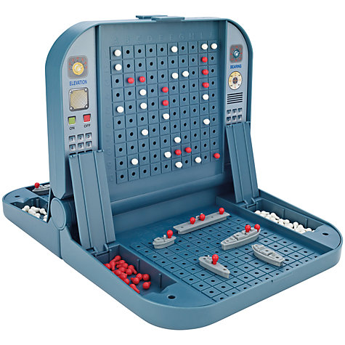
Battleship

Slide 31

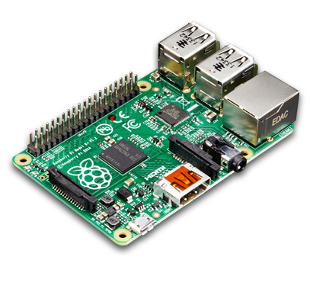
Introducing the Raspberry Pi
-Low-cost, credit-sized computer
-Plugs into a monitor, uses a standard keyboard and mouse
-Does everything you’d expect a computer to do
E.g. browsing the internet, play high-definition video, word-processing, play games, to make spreadsheets

Slide 32
Raspberry Pi
-Can be used to understand how computers work
-Has been used in a wide array of digital maker projects (from music machines and parent detectors to weather stations and tweeting birdhouses with infra-red cameras)

Slide 33
Pros vs cons
Advantages | Disadvantages
Cheap | Not particularly fast
Expandable | Has limited programs and apps
Easy to program | Has memory limitations

Slide 34
Ingredients for a Raspberry Pi
Raspberry Pi
Micro SD Card
Power Cable
Monitor + HDMI Cable
Keyboard + Mouse
WiFi Adapter

Slide 35
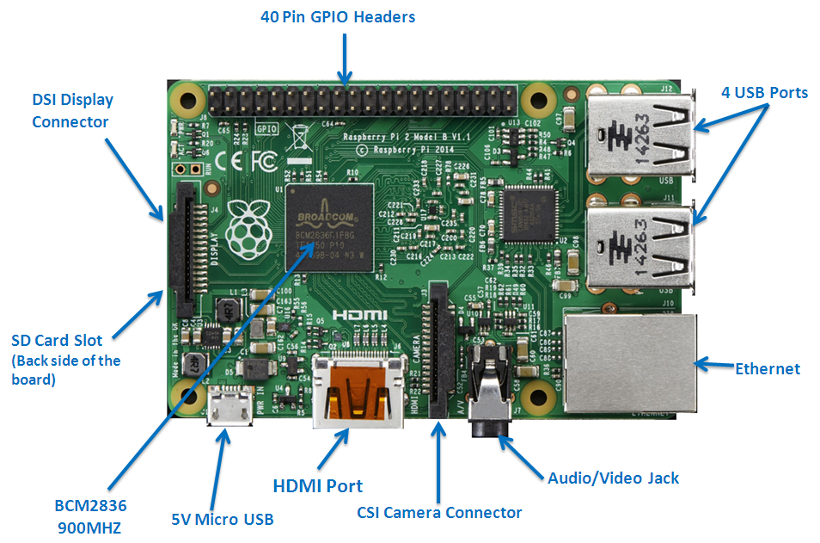
The anatomy of a Pi

Slide 36
Style
⇒ Style guide for Python. Recommended to follow the guide, but code still can work without. Main purpose is for the sake of consistency and legibility.
https://www.python.org/dev/peps/pep-0008/

Slide 37
Extra Tasks

Slide 38
Types of tasks
Level 0-A small step. Probably similar to what you have done.
Level 1-Slightly tougher, may be a simple program totally done by yourself
Level 2-Moderate challenge. Not so hard to pose a huge challenge, but it is meant to be a big step forward.
Level 3-Challenging. May need mastery of what knowledge you have learnt.

Slide 39
Tips
If program is stuck in infinite loop, press Ctrl-C
Spoilers are provided to give hints on how to do some tasks. The spoilers are white, so select the text to read them.

Slide 40
Teaching Computers How To Love (Level 0)
Computers have been said to be heartless, but with Python, you will change all of this. Print the following
_ _
( v )
\ /
v
Note: A backslash (\) is keyed in using this: “\\” due to the special meaning a backslash has. Also, you can print newlines using “\n” to separate the lines. For this, copy and paste line by line, including all the whitespace at the front.

Slide 41
Number Guessing Game (Level 1)
A game you probably played yourself. Generate a random number (usually 1-100), and continuously let the user guess. For every guess, you either say “lower”, “higher”, or “correct answer”. Make such a game in python.
Note: To generate random numbers, you will need two things.
“import random” at the start before anything
“random.randint(1, 100)” generates a number from 1 to 100, inclusive of 1 and 100, and returns a number which can be stored in a variable

Slide 42
Games (Level 3)
Tic Tac Toe
Connect 4 (implemented on https://github.com/jerrayl/Connect4)
Hangman
Choose your own adventure
Simon
Trivia Quiz

Slide 43
THANK YOU
for saving the world!

